Slide 1
Implementing Strategies: Management and Operations Issues
Chapter Seven

Slide 2
The Nature of Strategy Implementation
Strategy formulation is positioning forces before the action.
Strategy implementation is managing forces during the action.
Strategy formulation focuses on effectiveness.
Strategy implementation focuses on efficiency.

Slide 3
The Nature of Strategy Implementation
Strategy formulation is primarily an intellectual process.
Strategy implementation is primarily an operational process.
Strategy formulation requires good intuitive and analytical skills.
Strategy implementation requires special motivation and leadership skills.

Slide 4
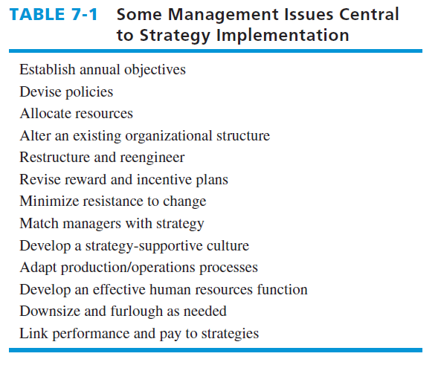
Some Management Issues Central to Strategy Implementation
(e.g. Employee’s leaves of absence)

Slide 5
Annual Objectives
Annual objectives:
represent the basis for allocating resources
are a primary mechanism for evaluating managers
are the major instrument for monitoring
progress toward achieving long-term objectives
establish organizational, divisional, and departmental priorities

Slide 6
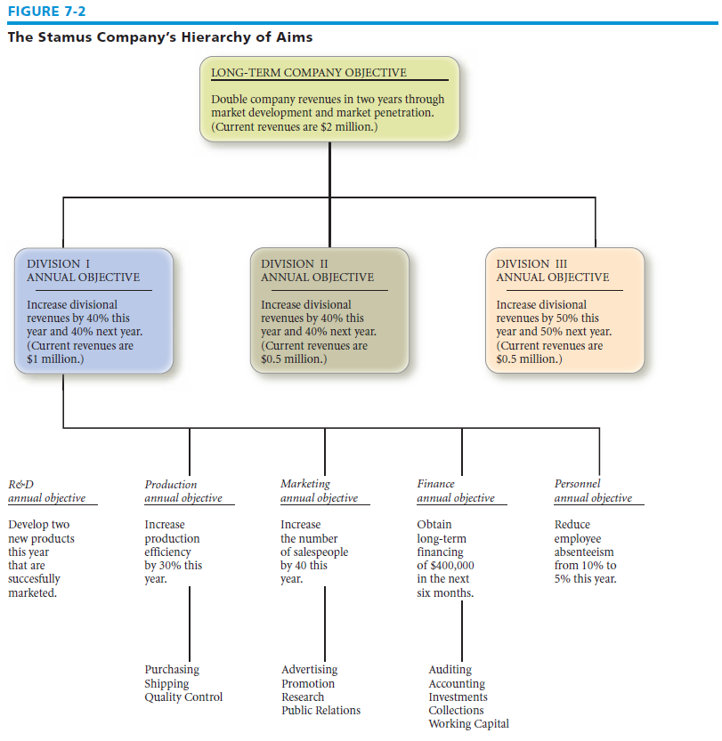
The Stamus Company’s Hierarchy of Aims

Slide 7
Policies
Policy
specific guidelines
Methods
Procedures
Rules
Forms
administrative practices established to support and encourage work toward stated goals
instruments for strategy implementation

Slide 8
Policies
Policies
set boundaries, constraints, and limits on the kinds of administrative actions that can be taken to reward and sanction behavior
clarify what can and cannot be done in pursuit of an organization’s objectives

Slide 9
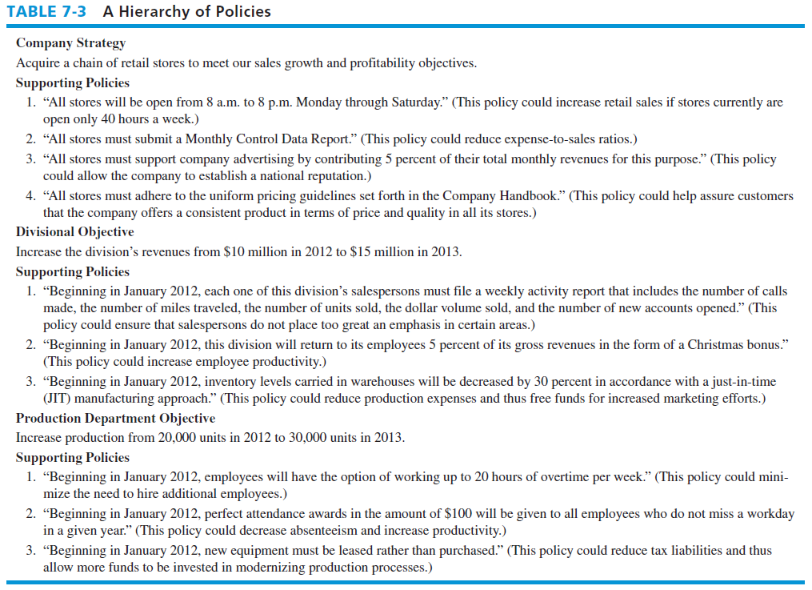
A Hierarchy of Policies

Slide 10
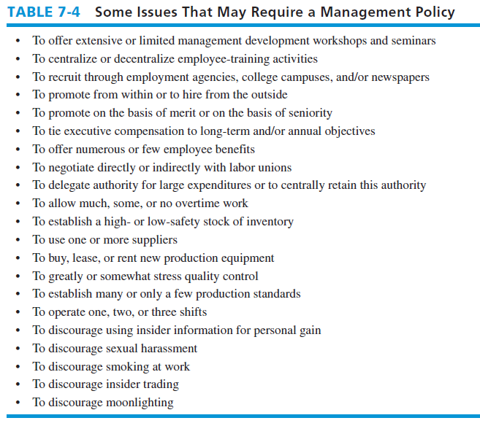
Some Issues That May Require a Management Policy

Slide 11
Resource Allocation
Resource allocation
Strategic management enables resources to be allocated according to priorities established by annual objectives

Slide 12
Types of Resources
Financial
Physical
Human
Technological

Slide 13
Managing Conflict
Conflict
disagreement between two or more parties on one or more issues
Establishing annual objectives can lead to conflict because individuals have different expectations and perceptions, schedules create pressure, personalities are incompatible, and misunderstandings occur between line managers and staff managers

Slide 14
Managing Conflict
Avoidance
includes such actions as ignoring the problem in hopes that the conflict will resolve itself or physically separating the conflicting individuals
Defusion
includes playing down differences between conflicting parties while accentuating similarities and common interests

Slide 15
Managing Conflict
Confrontation
exemplified by exchanging members of conflicting parties so that each can gain an appreciation of the other’s point of view or holding a meeting at which conflicting parties present their views and work through their differences

Slide 16
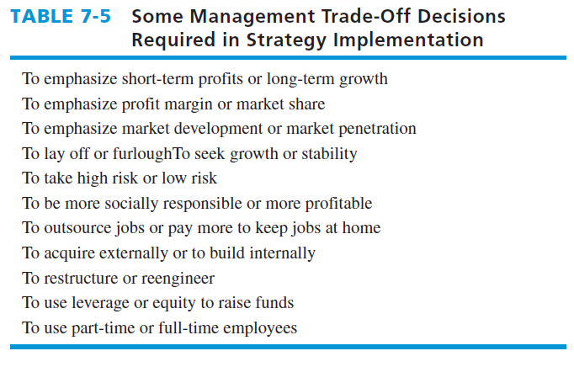
Some Management Trade-Off Decisions Required in Strategy Implementation

Slide 17
Matching Structure With Strategy
Structure largely dictates how objectives and policies will be established
Structure dictates how resources will be allocated

Slide 18
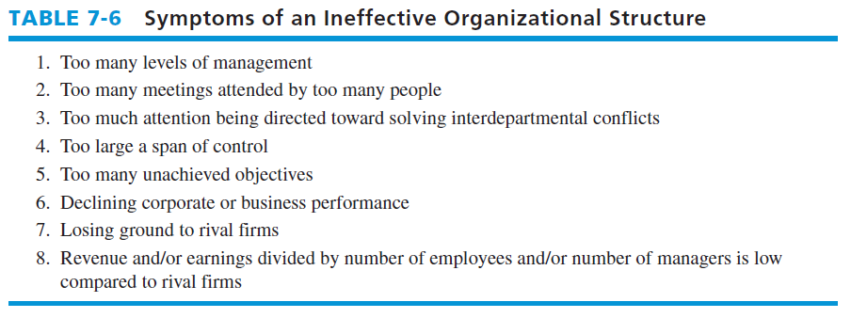
Symptoms of an Ineffective Organizational Structure

Slide 19
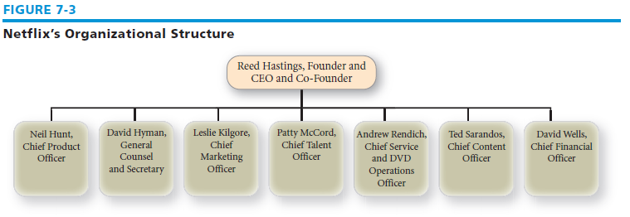
The Functional Structure
Functional structure
groups tasks and activities by business function, such as production/operations, marketing, finance/accounting, research and development, and management information systems

Slide 20
FUNCTIONAL STRUCTURE
Corporate Office
Organizes activities according to the specific functions that a company performs
Finance
Marketing/ Sales
Operations
R&D
Example
Platypus Technologies has 30 employees organized into small departments: finance, marketing, HR, and R&D

Slide 21
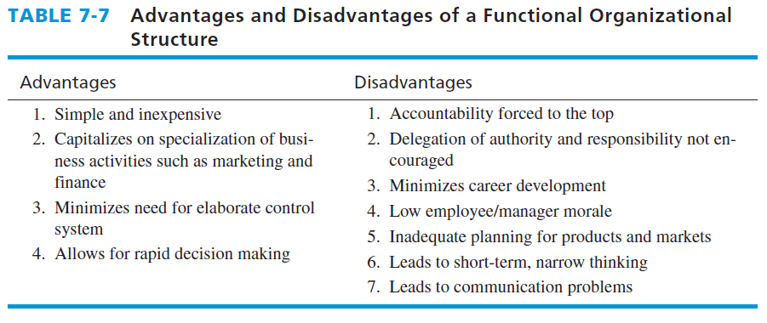
Advantages and Disadvantages of a Functional Organizational Structure

Slide 22
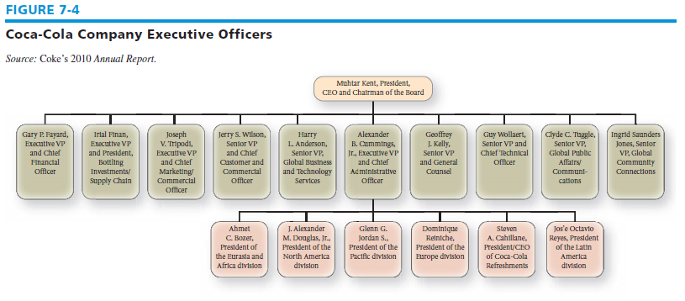
The Divisional Structure
Divisional structure
functional activities are performed both centrally and in each separate division
Geographic area, product or service, customer, process

Slide 23
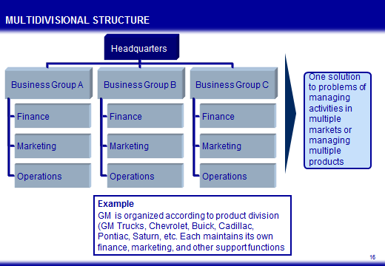
Divisional Structure

Slide 24
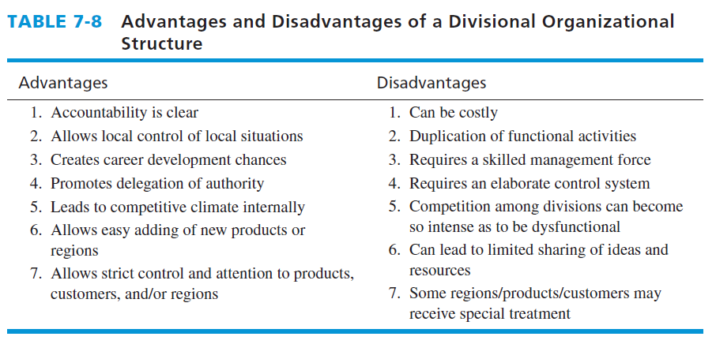
Advantages and Disadvantages of a Divisional Organizational Structure

Slide 25
The Strategic Business Unit (SBU) Structure
SBU structure
groups similar divisions into strategic business units and delegates authority and responsibility for each unit to a senior executive who reports directly to the chief executive officer
can facilitate strategy implementation by improving coordination between similar divisions and channeling accountability to distinct business units

Slide 26
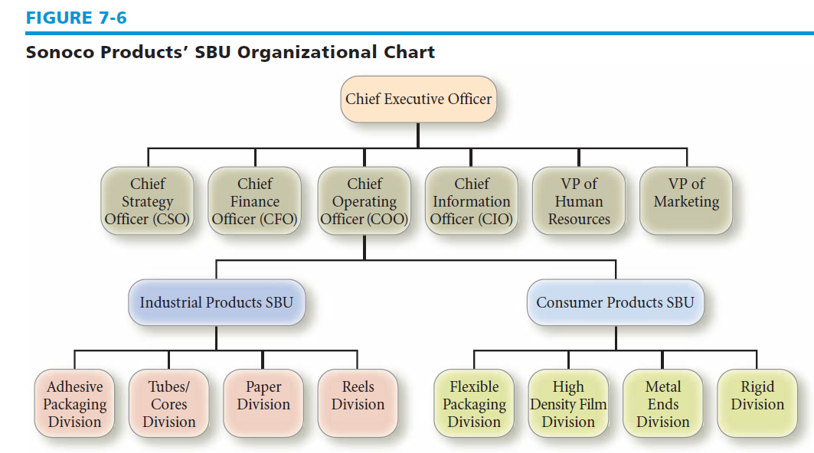
Sonoco Products’ SBU Organizational Chart

Slide 27
The Matrix Structure
Matrix structure
most complex of all designs because it depends upon both vertical and horizontal flows of authority and communication

Slide 28
The Matrix Structure
For a matrix structure to be effective, organizations need participative planning, training, clear mutual understanding of roles and responsibilities, excellent internal communication, and mutual trust and confidence

Slide 29
MATRIX STRUCTURE
Corporate Office
Product or Region A
Product or Region B
Product or Region C
Product or Region D
R&D
Hybrid between functional and multidivisional structure
Operations
Marketing
Finance
Source: http://www.cio.com/archive/090103/hs_reload.html

Slide 30
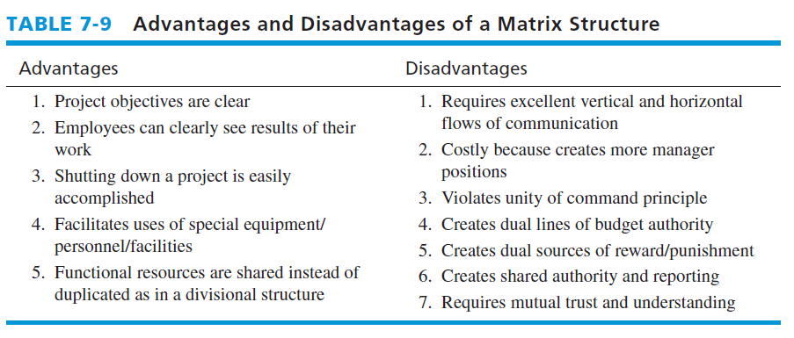
Advantages and Disadvantages of a Matrix Structure

Slide 31
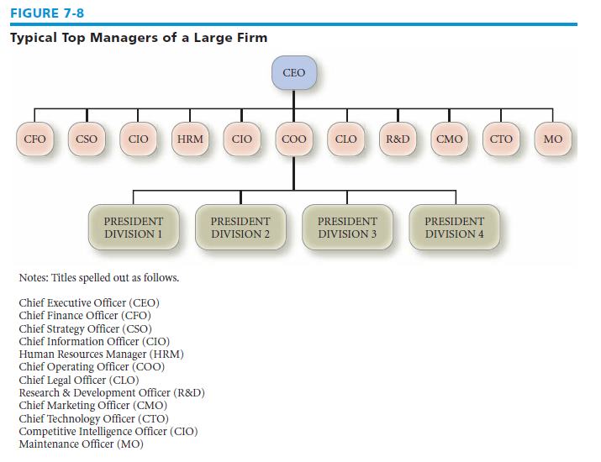
Typical Top Managers of a Large Firm

Slide 32
Restructuring
Restructuring
involves reducing the size of the firm in terms of number of employees, number of divisions or units, and number of hierarchical levels in the firm’s organizational structure
also called downsizing, rightsizing, or delayering

Slide 33
Reengineering
Reengineering
involves reconfiguring or redesigning work, jobs, and processes for the purpose of improving cost, quality, service, and speed
also called process management, process innovation, or process redesign

Slide 34
Linking Performance and Pay to Strategies
Provide full transparency to all stakeholders
Reward long-term performance with long-term pay, rather than annual incentives
Base executive compensation on actual company performance, rather than on stock price

Slide 35
Linking Performance and Pay to Strategies
Extend the time-horizon for bonuses.
Replace short-term with long-term incentives
Increase equity between workers and executives. Delete many special perks and benefits for executives

Slide 36
Managing Resistance to Change
Force change strategy
involves giving orders and enforcing those orders
Educative change strategy
one that presents information to convince people of the need for change
Self-interest change strategy
one that attempts to convince individuals that the change is to their personal advantage

Slide 37
Creating a Strategy-Supportive Culture
Formal statements of organizational philosophy, charters, creeds, materials used for recruitment and selection, and socialization
Designing of physical spaces, cubicles, offices, buildings
Deliberate role modeling, teaching, and coaching by leaders
Explicit reward and status system, promotion criteria
Stories, legends, myths, and moral tale about key people and events

Slide 38
Creating a Strategy-Supportive Culture
What leaders pay attention to, measure, and control
Leader reactions to critical incidents and organizational crises
How the organization is designed and structured
Organizational systems and procedures
Criteria used for recruitment, selection, promotion, leveling off, retirement, and “excommunication” of people

Slide 39
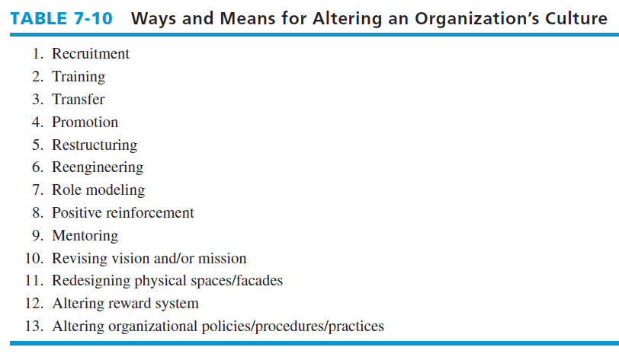
Ways and Means for Altering an Organization’s Culture

Slide 40
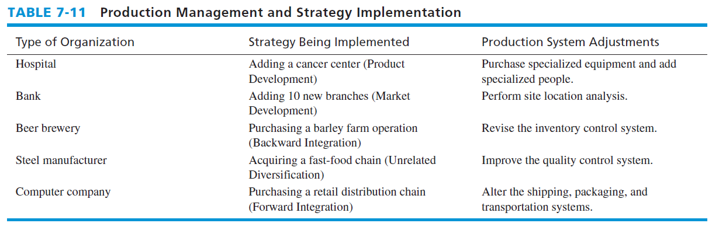
Production Management and Strategy Implementation

Slide 41
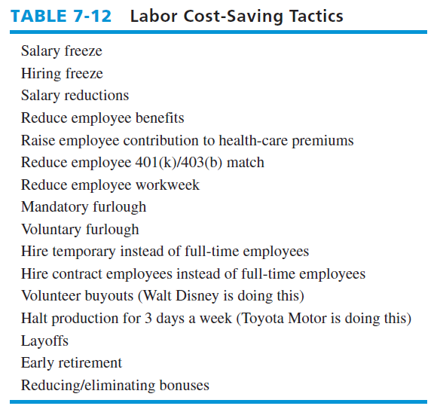
Labor Cost-Saving Tactics

Slide 42
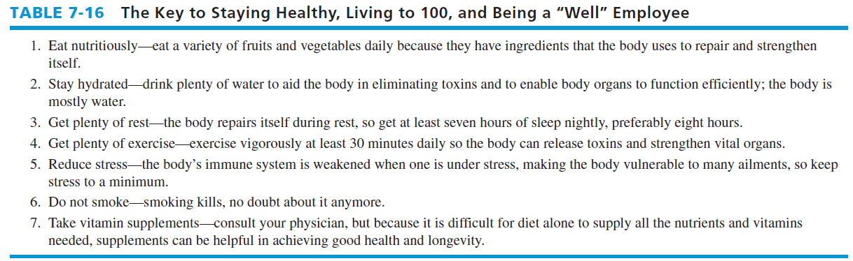
The Key to Staying Healthy, Living to 100, and Being a “Well” Employee

